Slide 1
Building Apps for the Office Store
Jim Epes, Office Store Product Marketing Manager
Scot Hillier, Office 365 MVP

Slide 2
How Store Apps are Different
Module 4

Slide 3

Agenda
Building for the Store: What Devs Gain
Constraints and Considerations
Building for Other Stores

Slide 4















Vision
EXTEND OFFICE EVERYWHERE
CONNECT TO OFFICE 365 SERVICES
BUILD USING AN OPEN PLATFORM
Delve
z
Users and groups
Files
Mail
Calendar
My Apps
Video Portal
Contacts
Office Graph
Presentations
Documents
Spreadsheets
Lync
OneNote
Yammer

Slide 5
What Developers Gain

Slide 6
Value-added Store services
Multi-tenant Support for SharePoint apps
Registering through Seller Dashboard enables multi-tenant & multi-site/farm deployment
Side-loading into SharePoint (the alternative) forces each Site Admin to register the app in each SharePoint site
App Management in Seller Dashboard*
Gives developers a place to store, edit, track and deploy all their apps, in one place
Provides central management of Client IDs & Secrets, and options for longer-lasting Secrets, for provider-hosted SharePoint apps
Can get download, trial and conversion metrics as well as sales reports
Quality Control
Store team provides FREE quality check to ensure your app is well performing, has quality marketing images, descriptions and screen shots
Sales & Tax tracking and payout
Microsoft handles all transactions conducted via the Store, including tax collection and payout across all applicable jurisdictions
Global Presence
By early 2015, Store will be localized in all 60 Office.com markets worldwide
* Office Developers can use many Seller Dashboard services even if not submitting to the Store

Slide 7
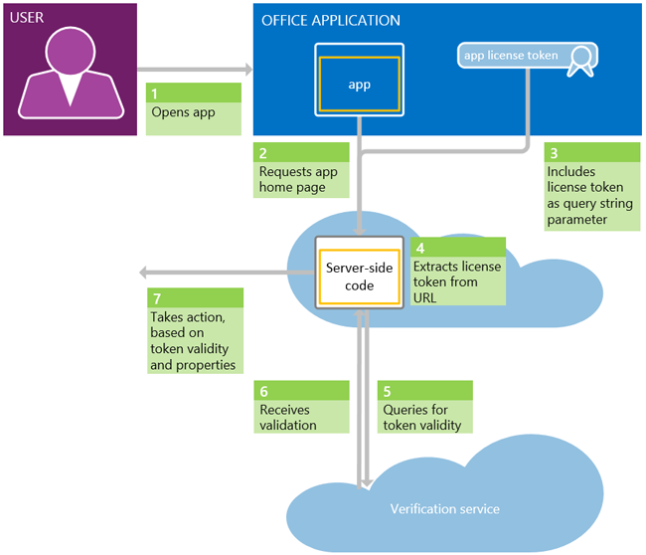
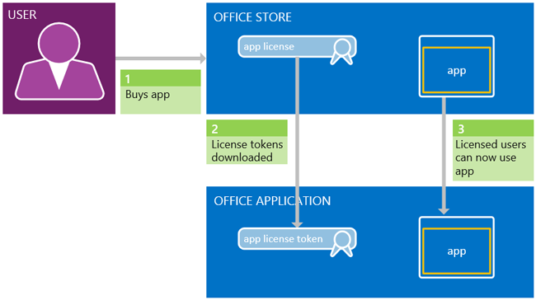
Store Licensing Services (sold directly or via app catalog)
Access to App Licensing Framework (saves ISV work)
Store retains a record of each license for verification & disaster recovery; has license APIs and verification web service
Apps for Office users can refresh/recover licenses from “My Apps” in ribbon; roam apps across PCs via MSA login
Devs can vary their apps’ behavior based on user status or license type
Anonymous users can now access Free / Unlimited Trial Office & SP apps by default; up to dev’s code to enforce sign-in or present alternate experience
Trial apps for all app types can be used to expose a different/more limited experience
Acquire App for Office
Use App for Office
Notes:
Validate the license
After the app receives the app license token, the app must pass it to the Office Store verification web service to determine that the license is valid and the information it contains is accurate. The verification service returns whether the license is valid and the license attribute values. The app code can then take appropriate action, based on whether the license is valid and on the license information.
Note: The Office Store verification service does not support being called from client-side code. For apps for Office, you are required to use server-side code to query the Office Store verification web service. For apps for SharePoint, if you are hosting your app pages on SharePoint, you can use the SharePoint web proxy to make JavaScript calls to the Office Store verification service. However, for security reasons we strongly recommend that you only use server-side code.

Slide 8
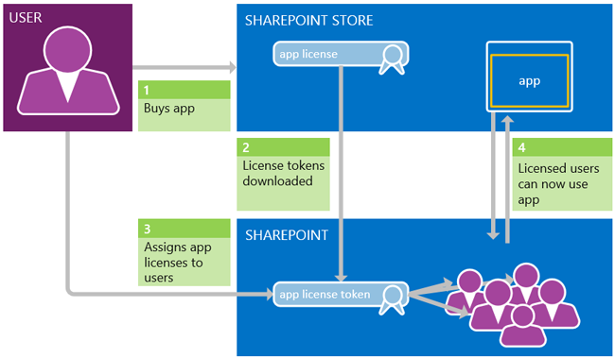
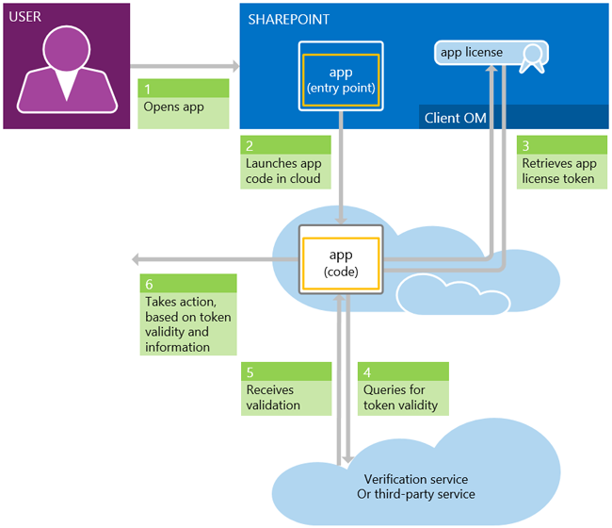
SharePoint Licensing
Site / farm admin must acquire licenses
Can use SharePoint app catalog to assign licenses or delegate license management
SP-hosted apps can use the SP Web Proxy to call the verification service, but server-side code is far more secure method
Use SP Apps
Acquire SP apps
Notes:
The right figure shows the app license query and validation process for apps for SharePoint.
The user launches the app from within SharePoint.
This launches the app code in the cloud.
When the app needs to verify a user’s app license, it uses server-side code to query SharePoint, via the client object model, for the app license token.
It then passes that token to the Office Store verification service.
The verification service returns whether the license token is valid, and if it is, also returns the license properties.
The app can then take action, based on the validity of the license and its properties.

Slide 9
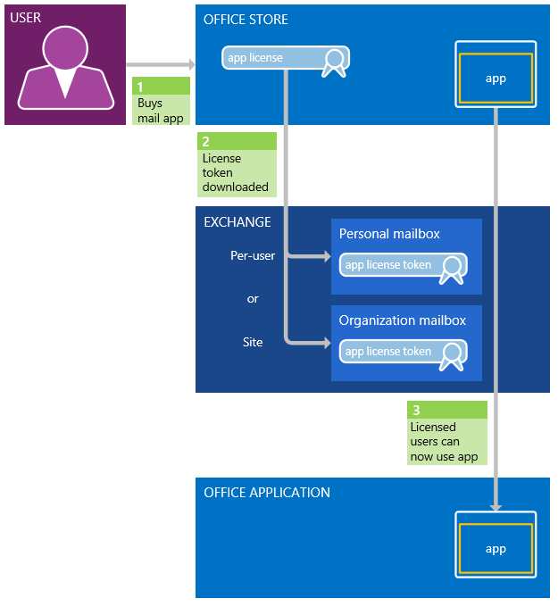
Mail app licenses
Mail apps can be acquired at the individual or site (Exchange) levels; tokens stored differently
For License Schemas, detailed Best Practices, and How-To’s on adding License Checks to Your App:
http://msdn.microsoft.com/en-us/library/office/jj163257(v=office.15).aspx
Mail Apps

Slide 10
Constraints and Considerations

Slide 11
Constraints
App onboarding to Store takes time and careful planning
Module 3 of this course walks through the requirements in detail
Must have formal Privacy and Support policies, and provide various marketing assets
Must comply with strict rules around your account profile, app versioning, app localization process, etc.
SharePoint Apps cannot require or bestow Full Control privileges on users who lack them
Any such app will be rejected during validation as a security risk
Commerce options are limited
Many ISVs have complex, tiered and one-off pricing models; the Store does not support every flavor
Task Pane & Content apps: licensable only per-user; SharePoint and Mail apps: per user or site/org wide
Some ISVs use the Store for lead generation, then close sales on their own platforms
The Store is adding significant upsell and Trial-conversion tools in 2015 to help with this, and considering edits to its Commerce model
Not all app types are marketable via the Office Store (yet)
Office 365 apps, registered at the tenancy (OrgID) level with Azure AD, are not yet in the Store (this is coming)
Mobile apps that talk to Office are today found in device-specific stores

Slide 12
Store Dev Considerations
Be mindful of consistent app naming during submission
Match App Name in Manifest and Seller Dashboard EXACTLY to avoid user confusion
Remember you must submit icons twice (for Store and in-app experiences)
Provider-hosted SharePoint Store apps require use of Seller Dash for Client IDs & Secrets
Client IDs and Secrets enable remote app components to gain access to SharePoint data without user credentials
When building for the Store, you CANNOT use SharePoint to create IDs and Secrets (OK for side-loaded apps)
These SD-created elements are then entered into the app’s web.config and Manifest files file in your Visual Studio project

Slide 13
Store Marketing Considerations
Think like a marketer
Offer Free/Trial app versions – let customers Try Before they Buy
Enable in-app purchase of data, tools, or services on your site
Hint at “premium” features in Free/Trial apps
Gray out, don’t hide Premium features (with call to upgrade)
Allow limited number of Premium-feature uses before upsell
Watch Module 5 of this MVA (demos Trial-app code to use)
Use rich media in app listing to capture buyers’ eye
Killer Screen shots, compelling video

Slide 14
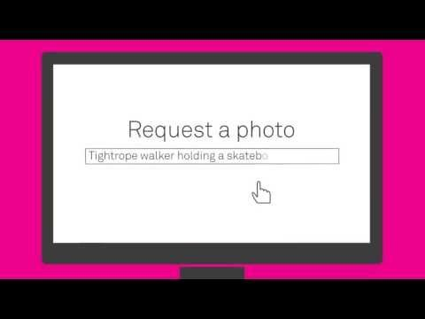
PicHit.Me Video
PicHitMe video on YouTube

Slide 15
Building for Other Stores

Slide 16
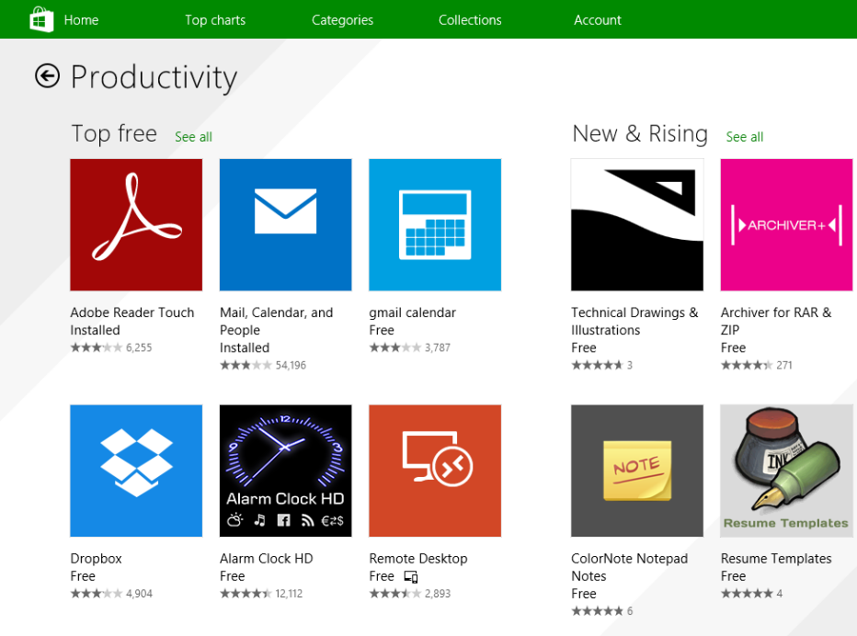
Windows Runtime Apps (WinRT)
Run on Windows PCs, tablets & Phones
Licensed in Windows/Windows Phone Stores
70% standard revenue share if sold via Store
Broader Commerce Model
Store fronts for 200+ countries/regions, in 100+ languages
Support for In-App Ads
User billing via mobile operators
“On-sale” app promotions (1hour-30 days)
Advanced tools
Data shared across Stores; download app from either place
Apply app “Badges” to signal status or new events
Link in-app data to Bing Searches
App-localization toolkit in Visual Studio
Automated app testing

Slide 17
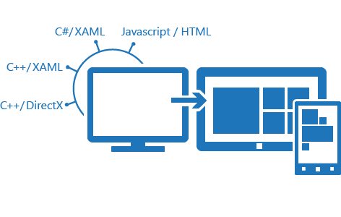
Build WinRT Apps
WinRT dev center found here: http://dev.windows.com/en-us
Build in many languages, incl. HTML5/JavaScript (see graphic)
Build for both Stores within same Visual Studio project template
Android and iOS apps can be ported to WinRT
App Certification Kit (in Win 8.1 SDK) helps w/ app testing
‘Getting Started’ process
Acquire Windows 8.1 & Visual Studio Phone dev tools
Install free Win Phone 8.1 emulator
Register your phone for development (to test your apps)
Register a Windows-specific Dev Account (US Registration Site)
Register an Individual ($19) or Company ($99) account; latter enables more powerful apps

Slide 18
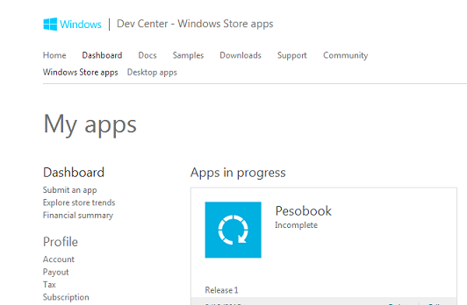
Submit WinRT Apps
Submit via Windows & Windows Phone Dashboards
Reserve an App Name
Honored across both Stores
Important, due to high volume of submissions
Follow Store-specific submission rules
E.g., image sizes, Age Ratings for Windows Apps
Use relevant Dashboard to:
Review download & sales metrics
Track app-crash reports
Respond to reviews
Submit Payout and Tax forms

Slide 19
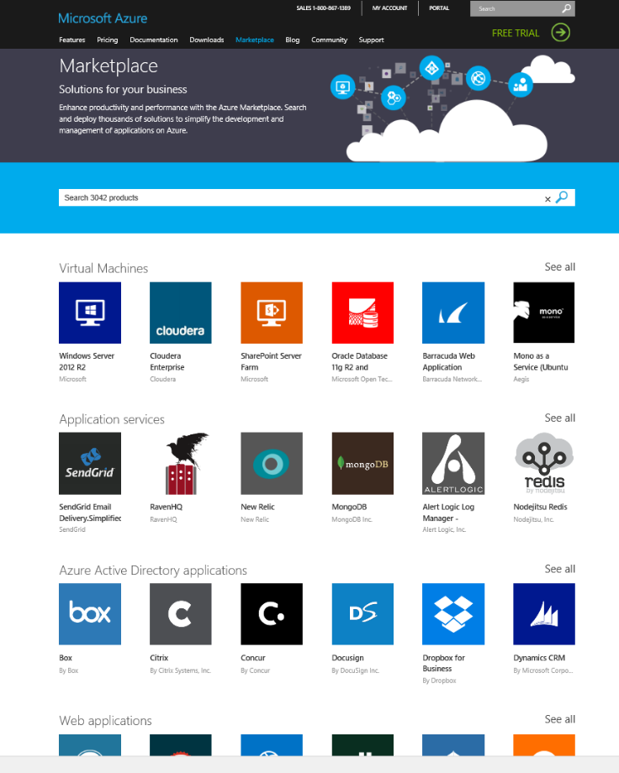
Microsoft Azure Marketplace
http://azure.com/marketplace/
Single place to offer Azure-based solutions worldwide
Virtual Machines: Solutions configured to run in Azure VMs
Application Services: For-sale 3rd party dev services (build/manage tools)
Azure AD apps: Pre-integrated Single Sign On SaaS apps
Web Apps: Free open-source apps configured to run on Azure Websites
Data Services: Licensable Data Sets & APIs for custom apps on Azure
Can transact across much of world
87 countries (web-direct) / 23 countries (EA customers)
Handles billing, reporting & account management
List of approved “sell from” countries is more limited
Marketplace consolidates older Azure portals
We’ll focus on the items in red
App Services: Must be Built On / Deployable To Azure

Slide 20

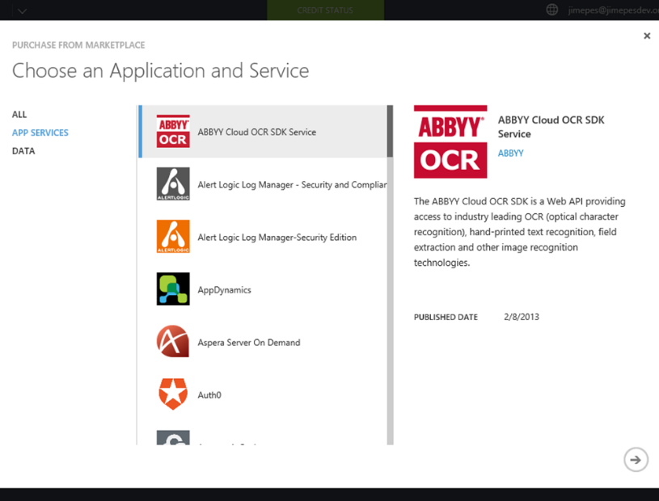
App Services & “Certified for Azure” program
Program Benefits
Publishers can sell in the Marketplace and access EA customers
Can tout their solution’s “Certified” status in their own channel
Easy customer deployment from Azure Management Portal
Marketing help via Azure self-service marketing portal/
Two Go To Market options
Integrated billing w/ Azure through customers’ Azure subscriptions
Monthly or Free pricing tiers (usage-based option coming)
Azure takes 20% Service Fee
ISV net share paid quarterly, if minimum of $250 earned
“BYO License” model: customer moves existing licenses to Azure
Requirements*
Onboard in Publishing Portal; sign Marketplace Publisher Agreement
Pass validation tests and conform to Azure Resource Provider API
Provide customer Technical Support (free, paid, Community)
*Partial list – full list at azure.com/certified

Slide 21
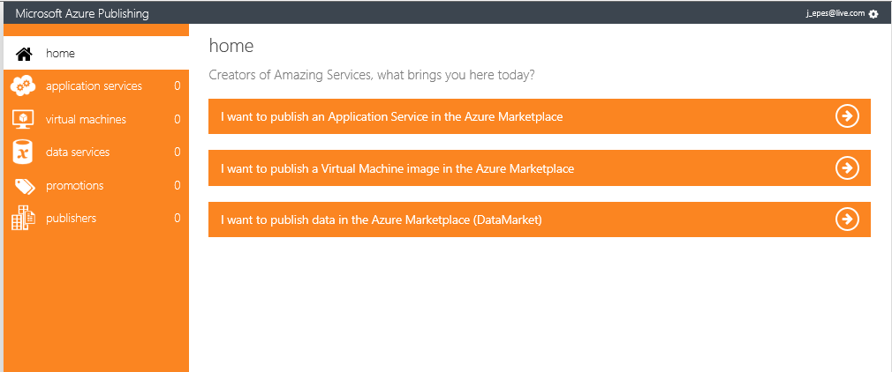
Submit Azure Application Services
Register as a merchant in Seller Dashboard (reuse Office account!)
Then create offers via Azure Publishing Portal (below)

Slide 22
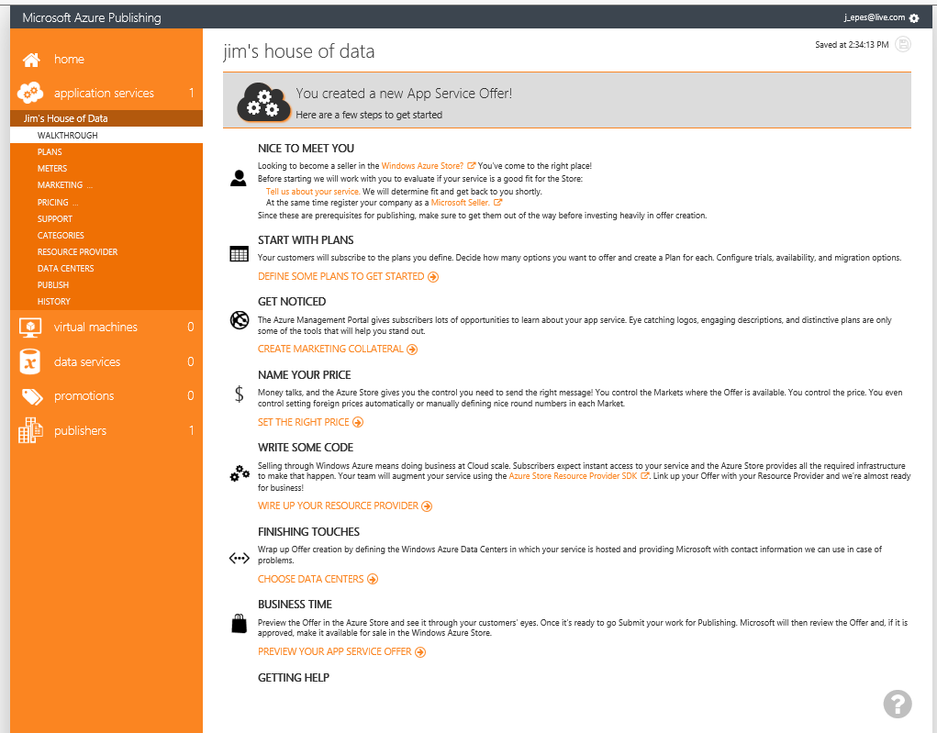
Publishing Portal: Azure-specific listing steps
https://publish.windowsazure.com/workspace/
Multiple “service plans” possible with Plan Migration, Trial & Promo Code options
Usage meters for VMs now; App Svces soon
Azure-specific metadata & logos per plan
Pricing & currency settings by country
Azure Categories unique; to refresh soon
Resource Provider: define Provisioning & SSO endpoints and User feedback keys
List Azure Data Centers hosting your app
Publish to Staging or Production

Slide 23
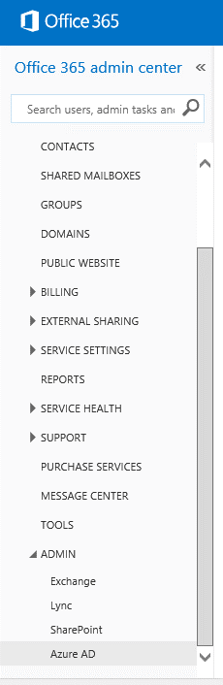
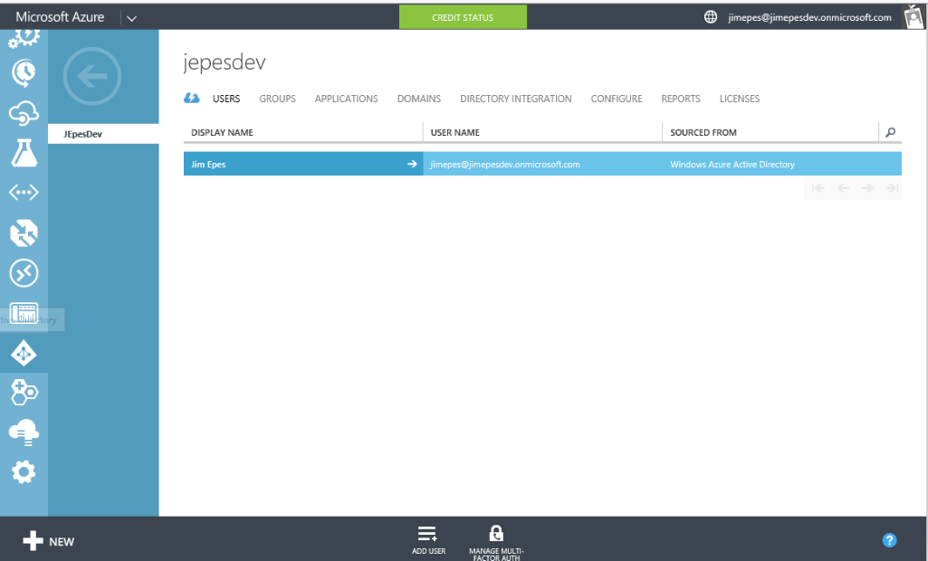
Azure AD apps: the big Office win
Apps registered w/Azure AD can integrate into O365 tenant experience via App Launcher
Do not have to run on Azure; simply be registered with AAD
Step 2: Admin selects relevant Azure AD Account (if >1)
Step 1: Admin launches Azure AD account from O365 Admin Portal & signs into Azure w/ 365 credentials

Slide 24
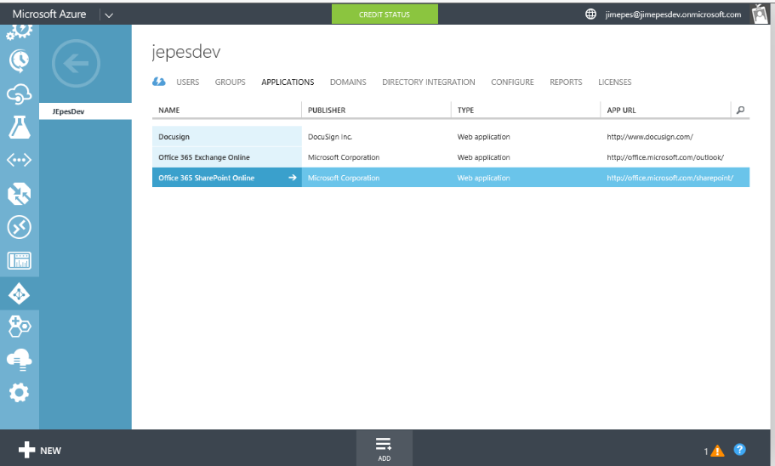
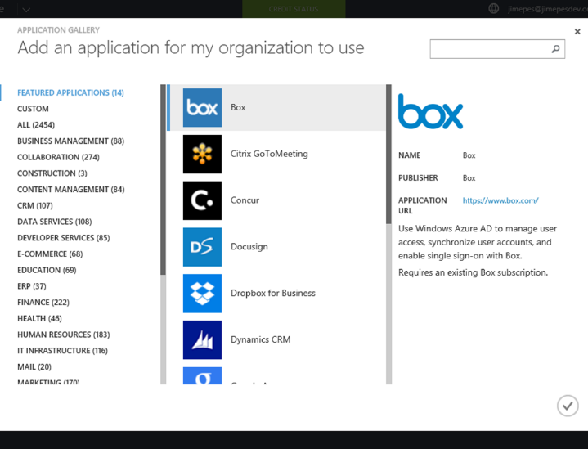
Surfacing Azure AD apps in the 365 experience
Step 5: Admin chooses app from App Gallery (assumes existing subscription)
Step 4: Admin clicks “ADD” button on bottom to add new app and then “add an application from the Gallery” in the resulting dialog box
Step 3: Admin Selects “Applications” tab at top to show existing Azure apps

Slide 25
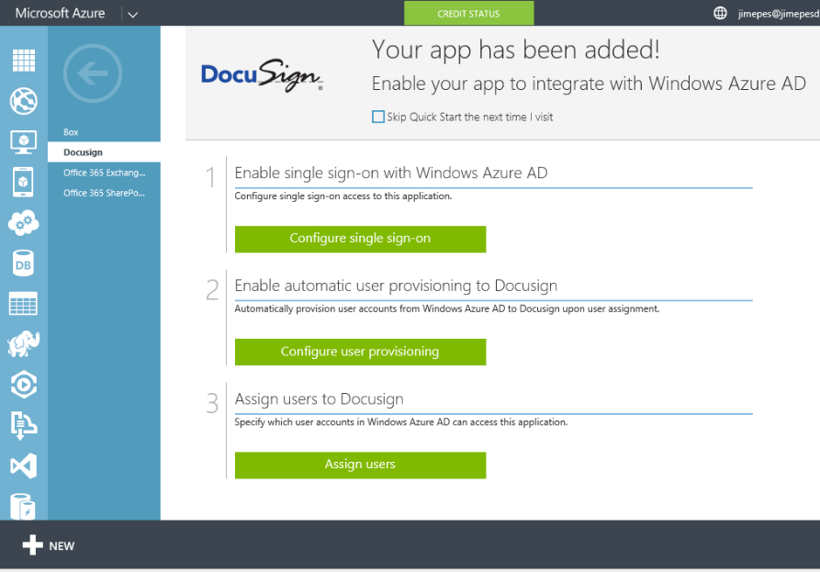
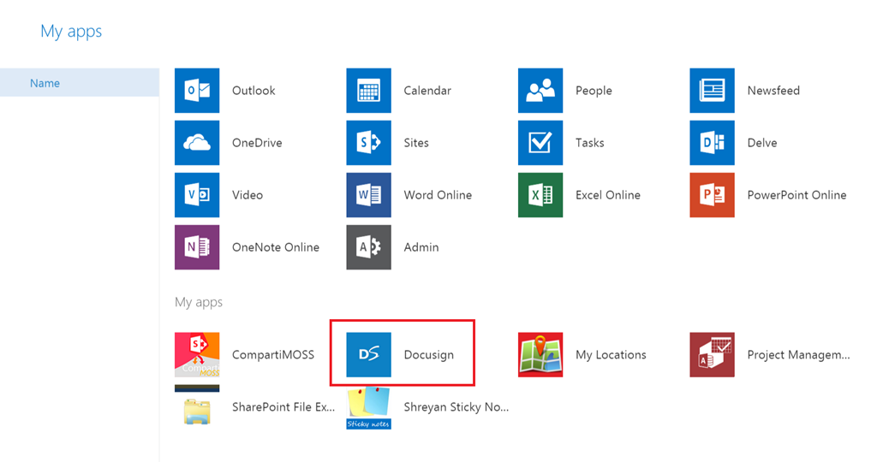
Configuring and Launching apps
Step 6: Admin configures:
SSO method (Azure AD)
URL of the Admin’s 3rd party (DocuSign) tenancy
Admin’s creds from 3rd party app (enables user provisioning)
List of 365 users assigned access to app (from Azure AD)
Step 7: Return to O365 App Launcher, select “My Apps” to launch app & do first-run Common Consent to give the app O365 data access

Slide 26
The Azure + Office 365 Story: Stay tuned
Look for increased integration of Azure and 365 app-management tools
Increased integration of dev onboarding tools
Addition of many SharePoint-scoped apps to the Azure AD tenant-wide story
Long-term push for a true B2B Store experience across all productivity services
We’ve heard your asks on this, and are working on it!

Slide 27
Summary
Building for the Store: What Devs Gain
Constraints and Considerations
Building for Other Stores

Slide 28
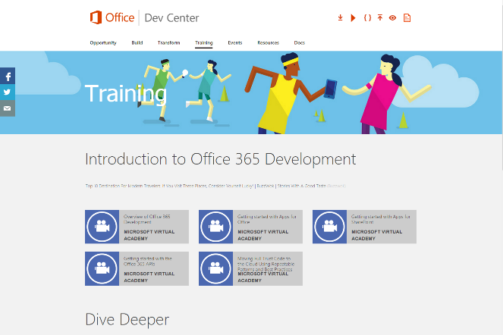
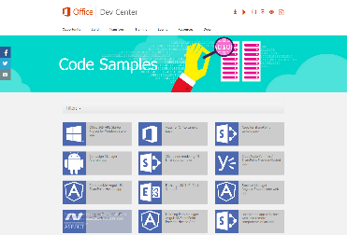
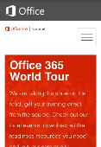
dev.office.com
Sign up
http://dev.office.com/getting-started
Explore
http://apisandbox.msdn.microsoft.com
Get trained http://dev.office.com/training

Slide 29


Feedback
Office 365 Network Share your best practices and join conversations https://www.yammer.com/itpronetwork
Stackoverflow Ask deep technical questions to a world-wide set of developers
http://stackoverflow.com/questions/tagged/ms-office
UserVoice Provide suggestions of what you want in future versions
http://officespdev.uservoice.com/

